Slide 1
Anomaly Detection In Hyperspectral Images Using Subspace Clustering
Shaked Cohen – 304920929
Ofir Refael Cohen - 203118591

Slide 2
Overview
The Objectives
Introduction
Hyperspectral images
What is clustering?
Why is it useful for us?
Motivation as a pre-processing tool
Relevant algorithms
K-Means
K-Subspaces
RX algorithm
Results
Realization and innovation
Findings
Future goals

Slide 3
The Objectives
Implement the K-Means and the K-Subspaces algorithms.
Create image segmentations with the algorithms.
Use the algorithms as pre-processing tool for to anomaly detection (using the RX algorithm).
Compare the results from the K-Subspaces algorithm and the K-Means algorithm.

Slide 4
A Short Introduction
Hyperspectral images
What is clustering?
Why is it useful for us?
Motivation as a pre-processing tool

Slide 5
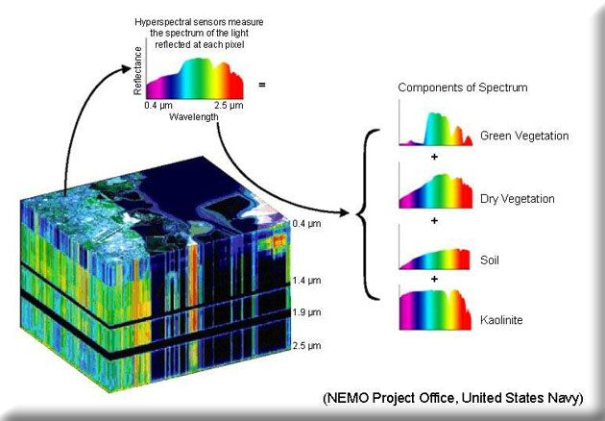
Hyperspectral Images
A 3D cube tensor.
where the X,Y axis of the cube represent geographical location.
The Z axis represents the different wavelengths.
Usually Z>100.

Slide 6




What Is Clustering?
Clustering is a method of unsupervised learning and is a common technique for statistical data analysis used in many fields.
Basically we classify each object from given data into a specific group (cluster).
Thus creating a form of image segmentation with unknown properties.
This data analysis method can be very useful for image segmentation.

Slide 7
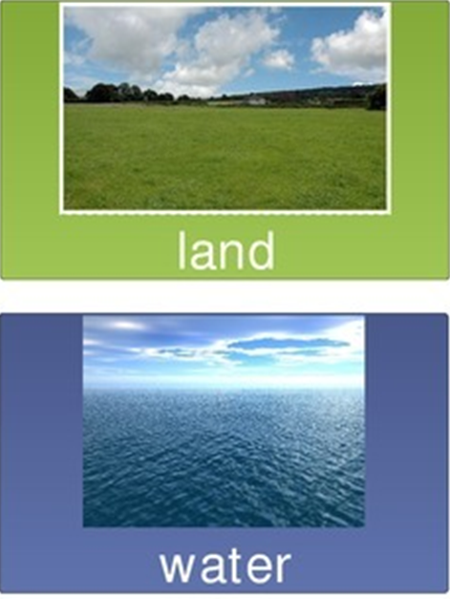
Why Is It Useful For Us?
The assumption is that objects from the same cluster have similar properties such as maybe water and land.
Segmented data can give us new light on the information we want to process, and new ways to use it as will be discussed.

Slide 8


Motivation As a Pre-Processing Tool
Finding an anomaly based on the cluster as compared to whole picture: changing the relevant surrounding.
Let's say you want to find a suspect,
Is it the lone man in the woods ?
Or the man with a different colored hat ?
This depends on how we look for the anomaly:
If you look at the immediate surrounding “the lone man in the woods” is your anomaly.
If you look at the group “people” in the image, then maybe “the man with a different colored hat ” is your anomaly.

Slide 9
Relevant algorithms
K-Means
K-Subspaces
RX algorithm

Slide 10
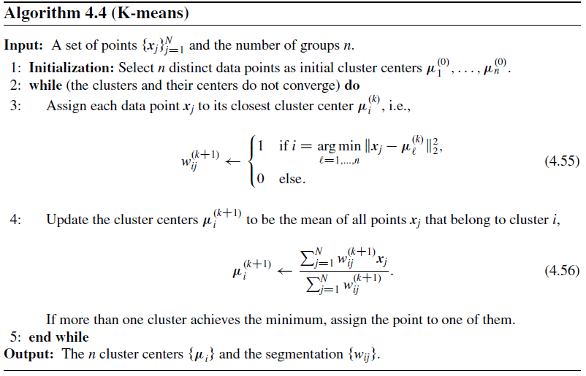
K-Means Clustering Algorithm
K-Means is a common clustering algorithm
that returns K clusters from the given data.

Slide 11
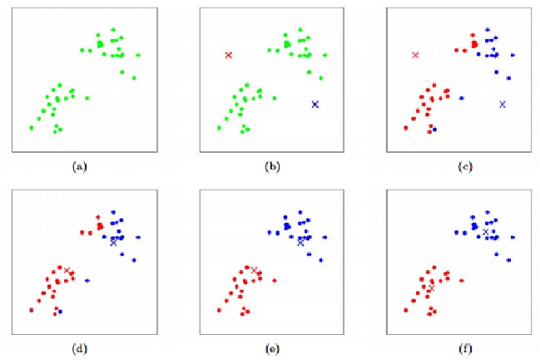
The Algorithm Visualized

Slide 12
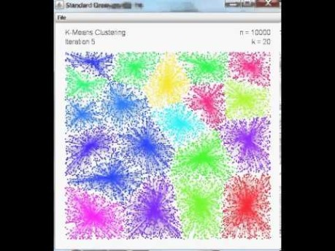
The Algorithm Visualized
A Short Video:
https://www.youtube.com/watch?v=BVFG7fd1H30

Slide 13
Pros and Cons
Pros:
Simple implementation
Good basic segmentation
Base for comparison
Good initialization for our algorithm
Fast to converge
Cons:
Assumes Gaussian distribution.
Creating only spherical (ball-shaped) data clusters.
A basic clustering method that doesn’t use the advantage of high dimensional data such as hyperspectral images.

Slide 14
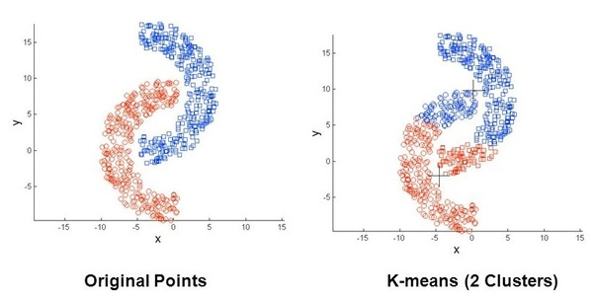
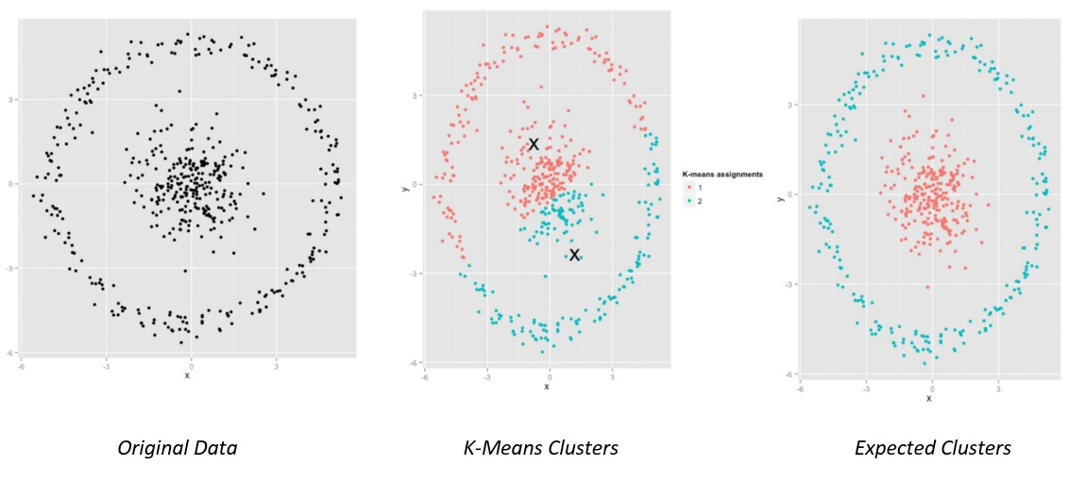
Examples of algorithm’s failure

Slide 15
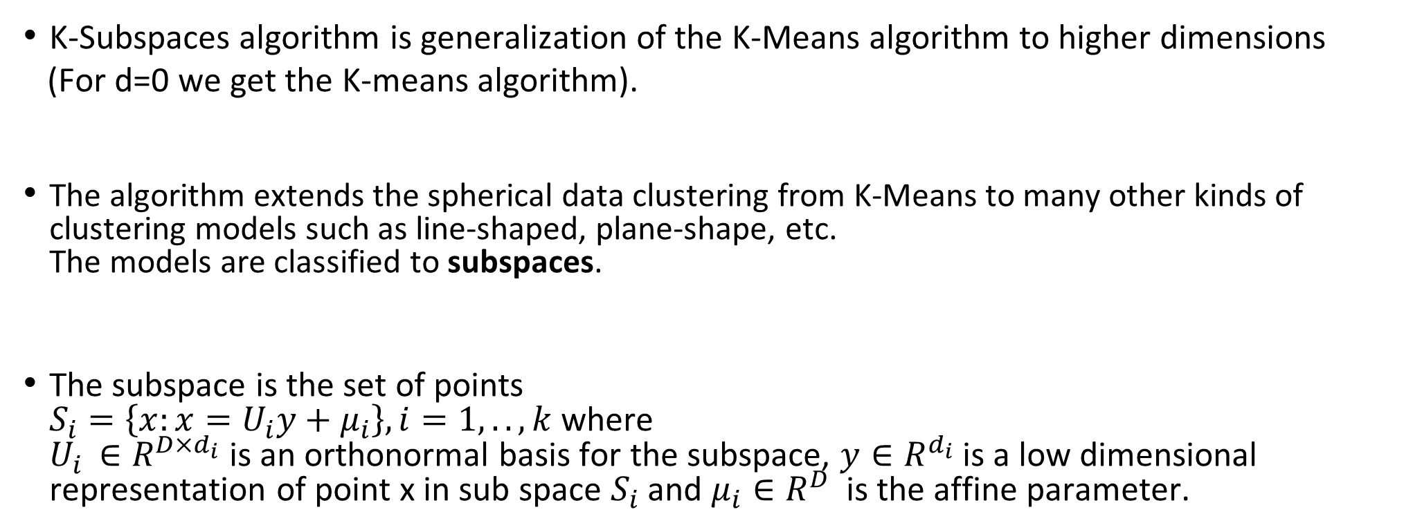
K-Subspaces Clustering Algorithm
K-Subspaces algorithm is generalization of the K-Means algorithm to higher dimensions
(For d=0 we get the K-means algorithm).
The algorithm extends the spherical data clustering from K-Means to many other kinds of clustering models such as line-shaped, plane-shape, etc. The models are classified to subspaces.
The subspace is the set of points $S_{i}=\left\{x:x=U_{i}y+μ_{i}\right\}, i=1,..,k$ where $U_{i }∈R^{D×d_{i}}$ is an orthonormal basis for the subspace, $y∈R^{d_{i}}$ is a low dimensional representation of point x in sub space $S_{i}$ and $μ_{i}∈R^{D}$ is the affine parameter.

Slide 16
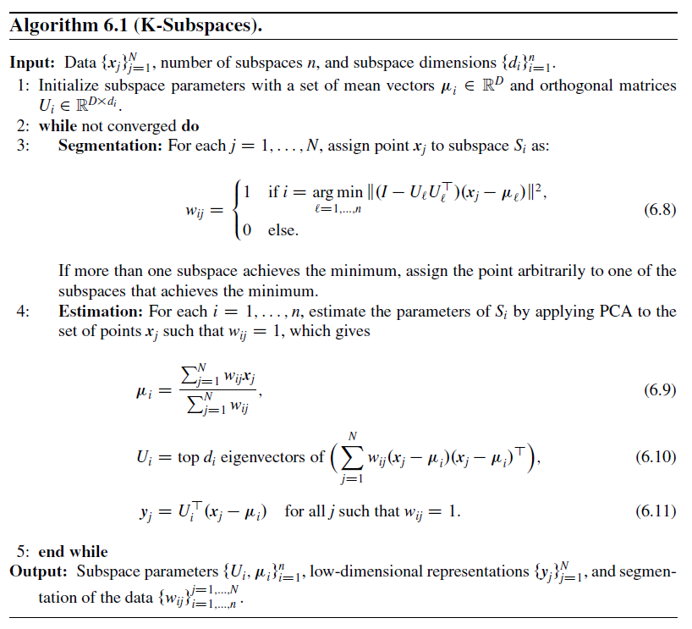
K-Subspaces Clustering Algorithm

Slide 17
Pros and Cons
Pros:
Generalization for K-Means.
Uses the advantages of high-dimensional data.
Can give low-rank representation of the data.
Extended clustering models.
Cons:
Initializing problems – K-Means as initializing is a good solver of the problem.
Doesn’t always converge to non-empty K-Subspaces, K-Means initialization provides good initial conditions for convergence.
We assume the dimensions of the subspaces are known.

Slide 18
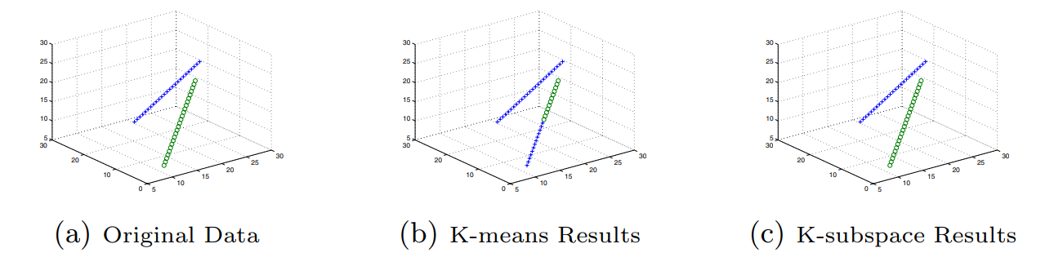
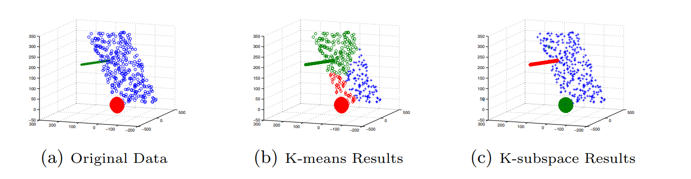
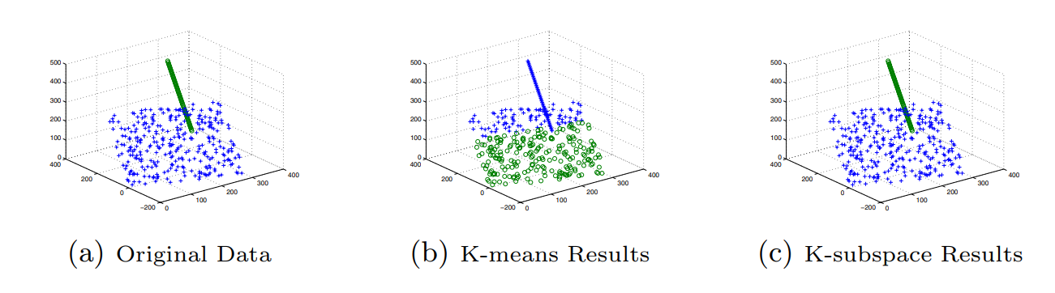
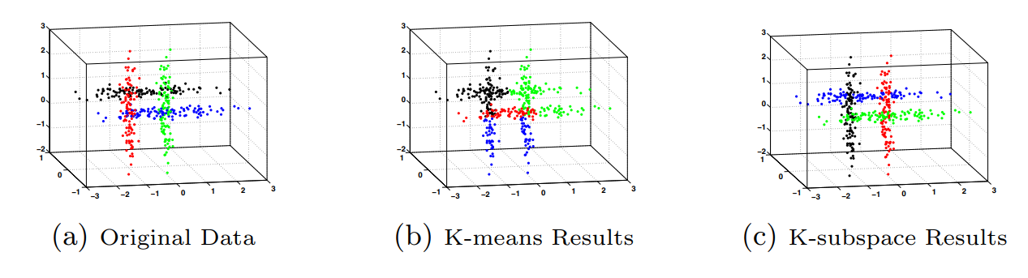
K-Subspaces Vs K-Means

Slide 19
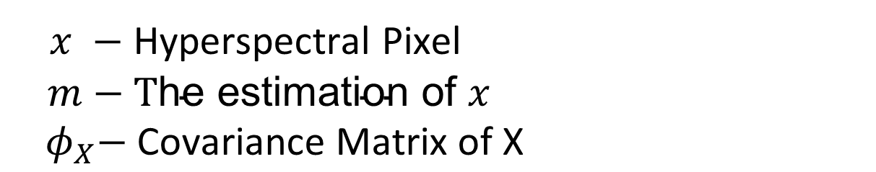

RX Algorithm – Anomaly Detection
The RX (Reed-Xiaoli) algorithm is given by:
$$r\left(x\right)= {\left(x−m\right)}^{T}φ_{X}^{−1}\left(x−m\right)$$
$x −$ Hyperspectral Pixel
$m−\text{T}\text{he} \text{estimation} \text{of} x$
${ φ}_{X}−$ $\text{Covariance} \text{Matrix} \text{of} \text{X}$
The RX algorithm detect targets that are spectrally distinct from the image background.

Slide 20

Now For The Results!!!

Slide 21
Dataset
The dataset used for this project is the self-test image from the RIT target detection dataset. It includes a hyperspectral image of Cooke City Montana. The image is of size 800 x 200 x 126 (126 spectral bands, each of size 800x200).
http://dirsapps.cis.rit.edu/blindtest/

Slide 22
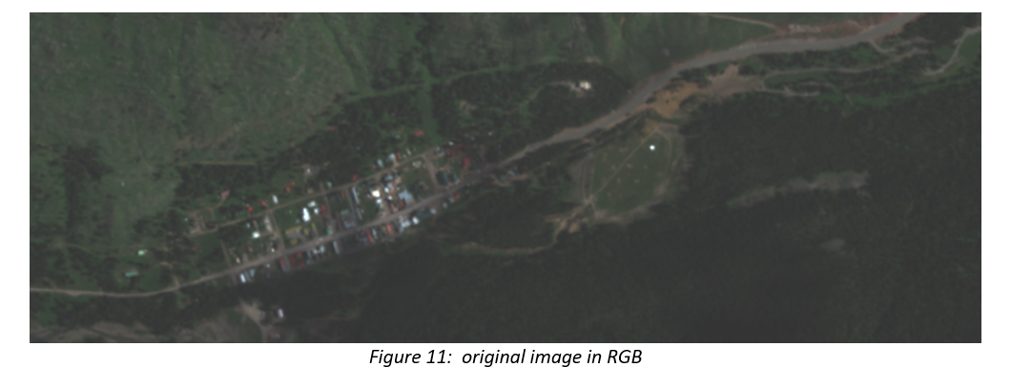
The Original Image

Slide 23
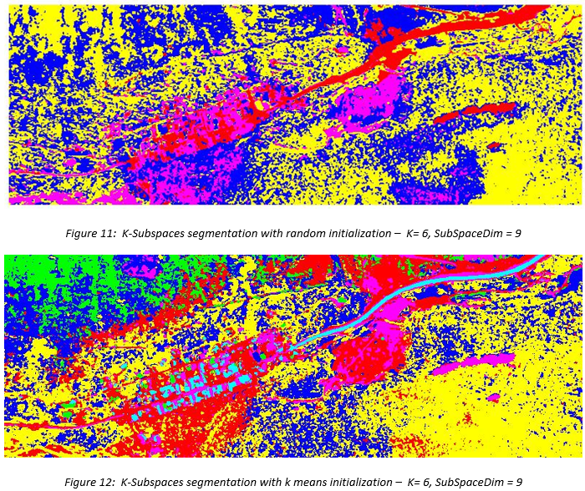
Algorithm implementation and initialization
The algorithms where implemented in MATLAB
K-Means
K-Subspaces
RX based algorithms
Initialization of the K-Subspaces algorithm can be a problem

Slide 24
K-Means Vs K-Subspaces
From this point forward the K-Subspaces algorithm is initialized using K-Means, and all the results are compared to the K-Means algorithm.

Slide 25
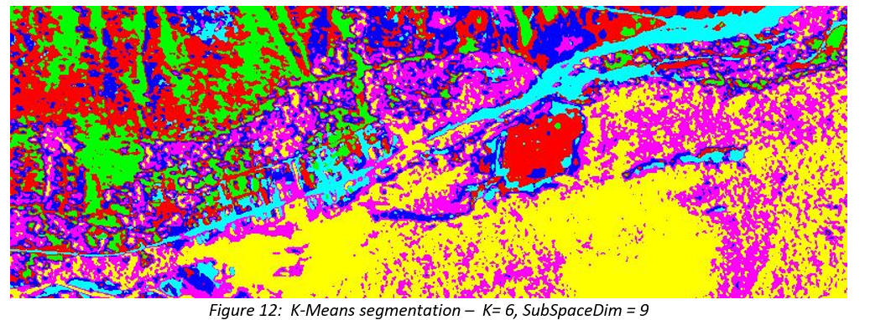
Segmentation using K-Means

Slide 26
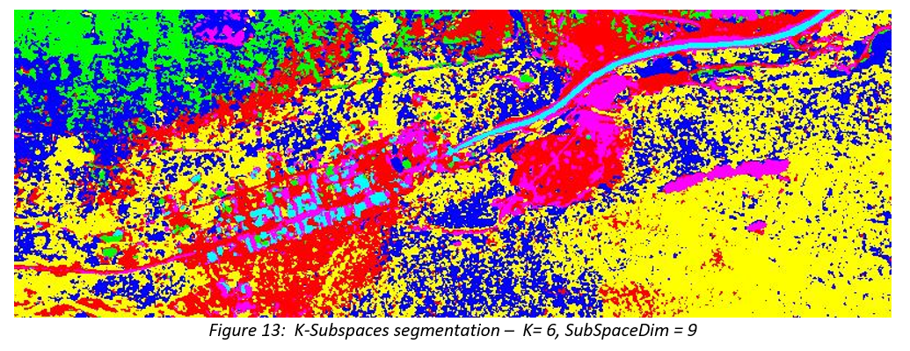
Segmentation using K-Subspaces
*(We initialized the K-subspaces algorithm with K-means)

Slide 27
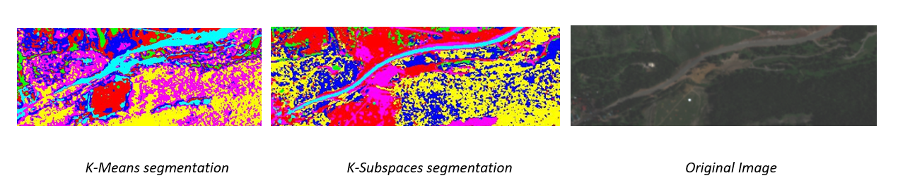
Segmentation Comparison
From the results, we can clearly notice that the K-Subspaces yields smoother segmentation results than K-Means. Here are some examples:
The road curves are sharper and less noisy in the K-Subspaces segmentation.

Slide 28
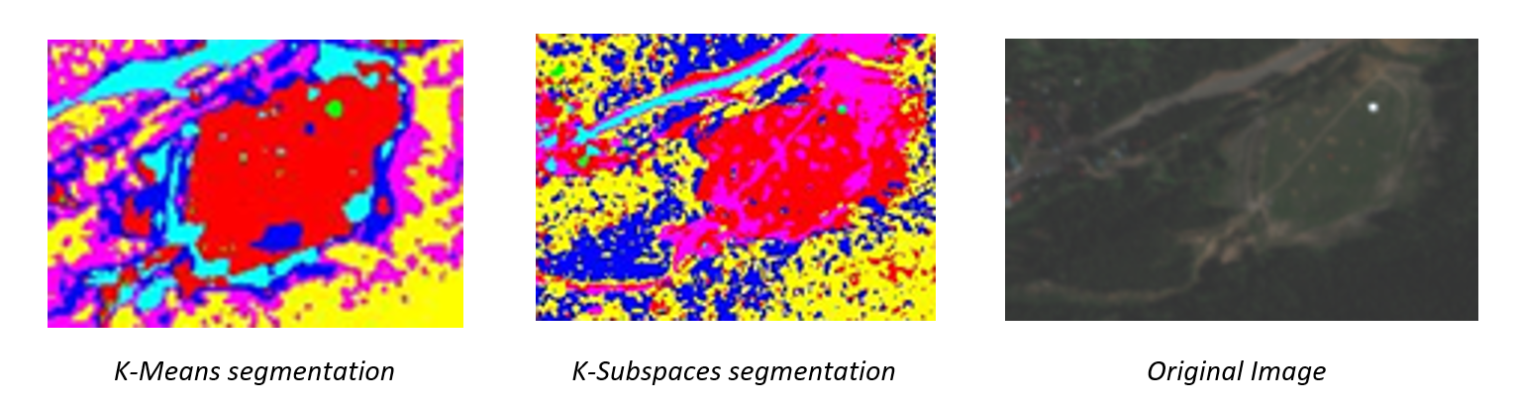
Segmentation Comparison
The K-Subspaces “recognized” the line and spots as seen from the images below (marked as pink) while K-Means did not.

Slide 29
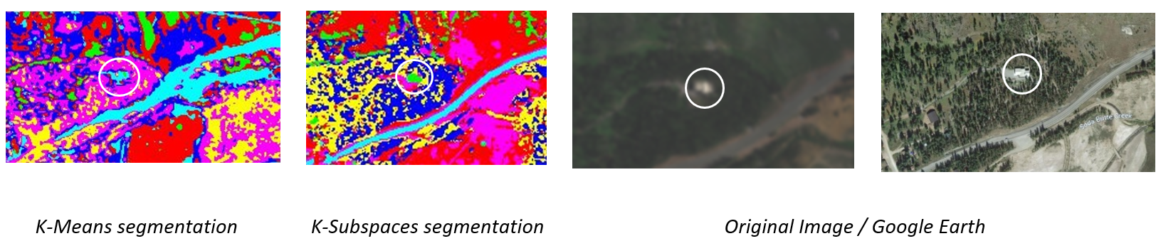
Segmentation Comparison
The K-Subspaces “recognized” the white building as seen from the images below (marked as green) while K-Means did not.

Slide 30

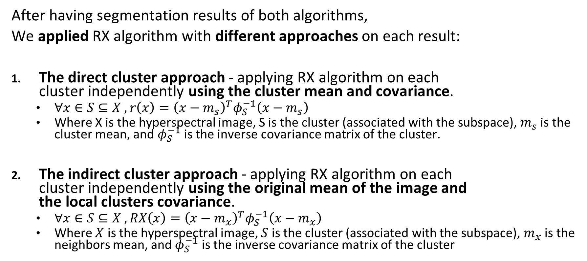
Realizations
After having segmentation results of both algorithms,
We applied RX algorithm with different approaches on each result:
The direct cluster approach - applying RX algorithm on each cluster independently using the cluster mean and covariance.
$∀x∈S⊆X , r\left(x\right)={\left(x−m_{s}\right)}^{T}φ_{S}^{−1}\left(x−m_{s}\right)$
Where X is the hyperspectral image, S is the cluster (associated with the subspace), $m_{s}$ is the cluster mean, and $φ_{S}^{−1}$ is the inverse covariance matrix of the cluster.
The indirect cluster approach - applying RX algorithm on each cluster independently using the original mean of the image and the local clusters covariance.
$∀x∈S⊆X , RX\left(x\right)={\left(x−m_{x}\right)}^{T}φ_{S}^{−1}\left(x−m_{x}\right)$
Where $X$ is the hyperspectral image, $S$ is the cluster (associated with the subspace), $m_{x}$ is the neighbors mean, and $φ_{S}^{−1}$ is the inverse covariance matrix of the cluster

Slide 31
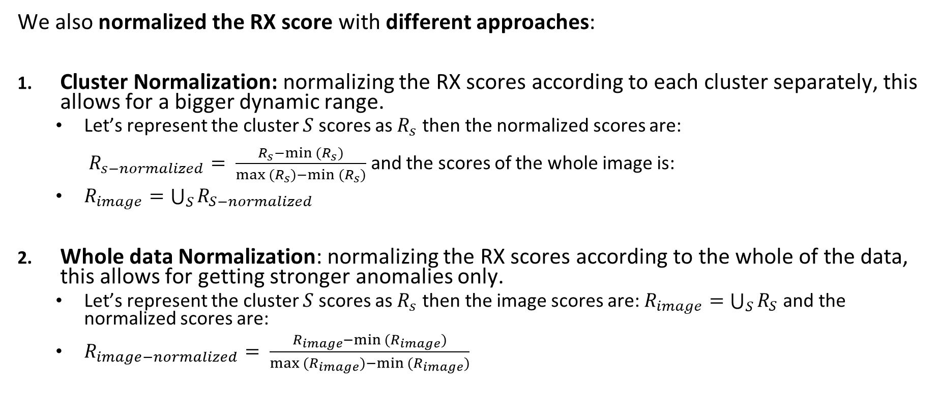
Realizations
We also normalized the RX score with different approaches:
Cluster Normalization: normalizing the RX scores according to each cluster separately, this allows for a bigger dynamic range.
Let’s represent the cluster $S$ scores as $R_{s}$ then the normalized scores are: $R_{s−normalized}= \frac{R_{s}−min (R_{s})}{max (R_{s})−min (R_{s})}$ and the scores of the whole image is:
$R_{image}=\bigcup_{S}{R_{S−normalized}}$
Whole data Normalization: normalizing the RX scores according to the whole of the data, this allows for getting stronger anomalies only.
Let’s represent the cluster $S$ scores as $R_{s}$ then the image scores are: $R_{image}=\bigcup_{S}{R_{S}}$ and the normalized scores are:
$R_{image−normalized}= \frac{R_{image}−min (R_{image})}{max (R_{image})−min (R_{image})}$

Slide 32
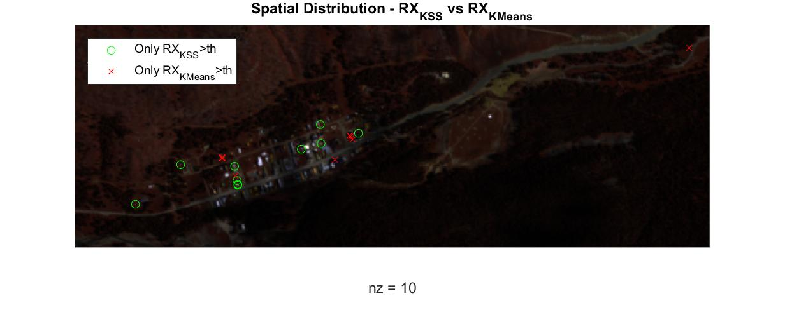
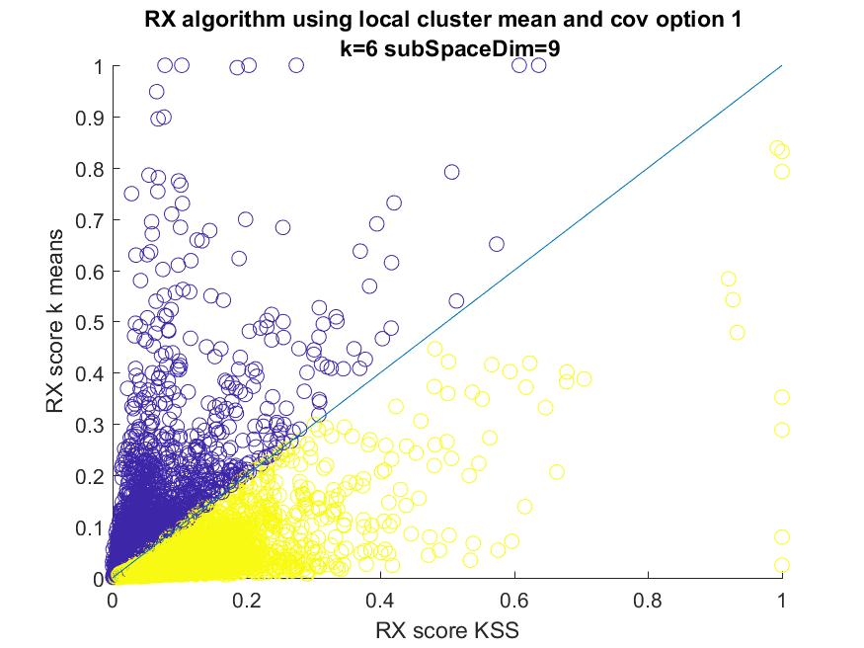
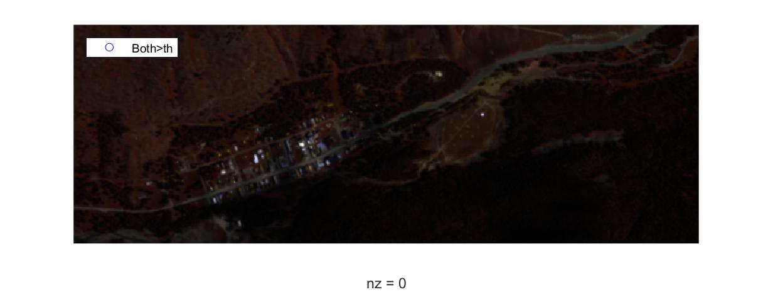
Findings
Direct cluster approach – applying RX algorithm on each cluster independently using the cluster mean and covariance.
- Cluster Normalization.

Slide 33
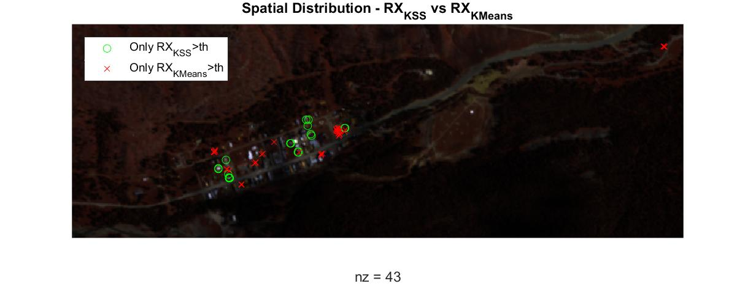
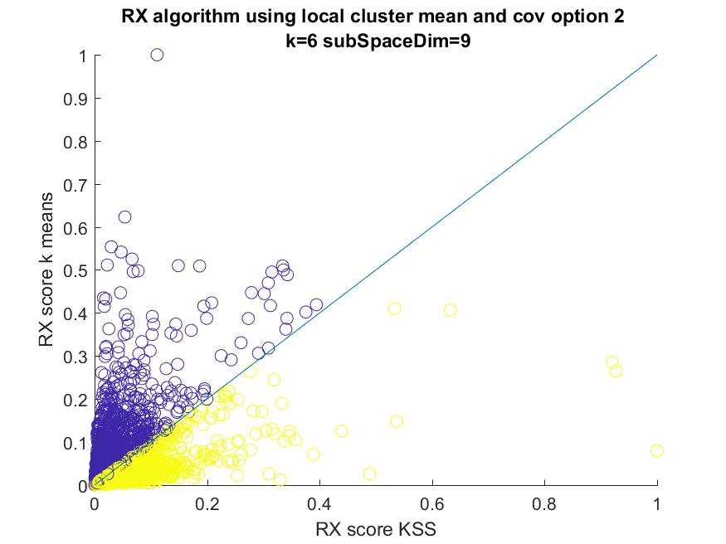
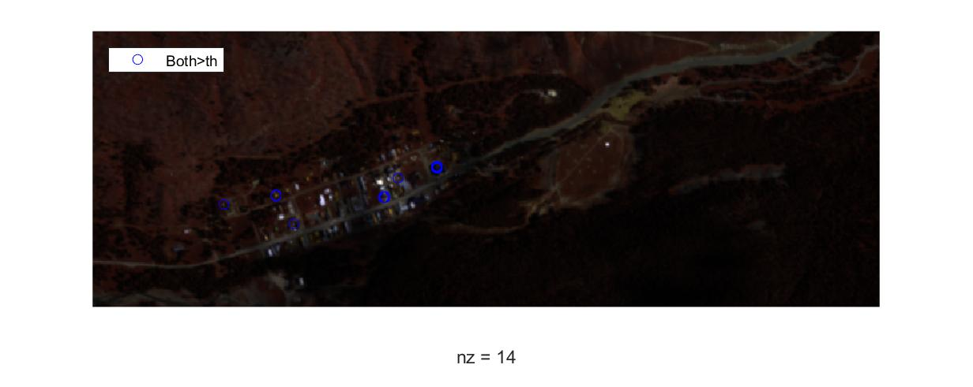
Findings
Direct cluster approach – applying RX algorithm on each cluster independently using the cluster mean and covariance.
- Whole data Normalization.

Slide 34
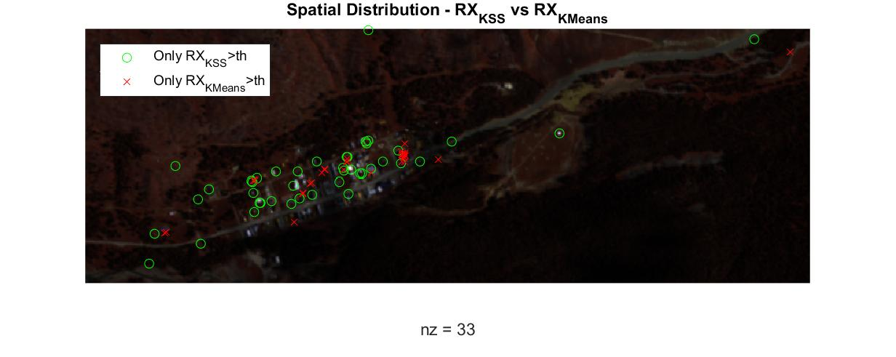
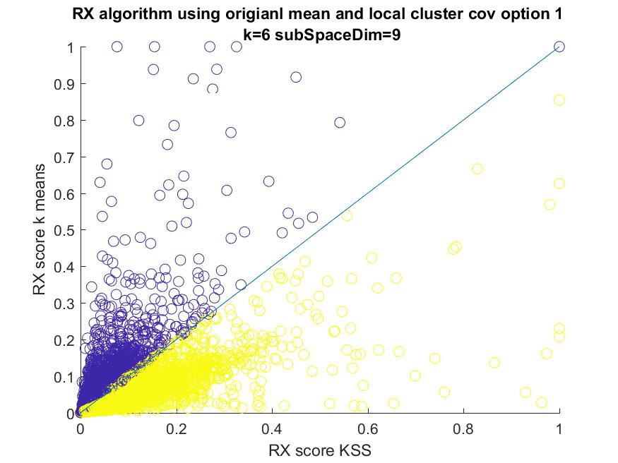

Findings
Indirect cluster approach – applying RX algorithm on each cluster independently using the original mean and the local clusters covariance.
- Cluster Normalization.

Slide 35
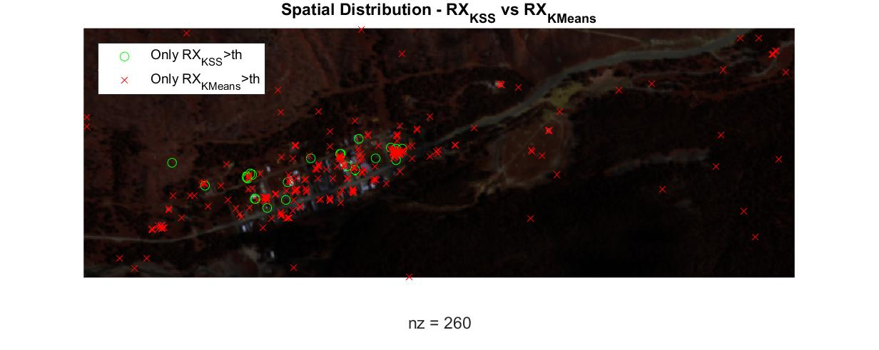
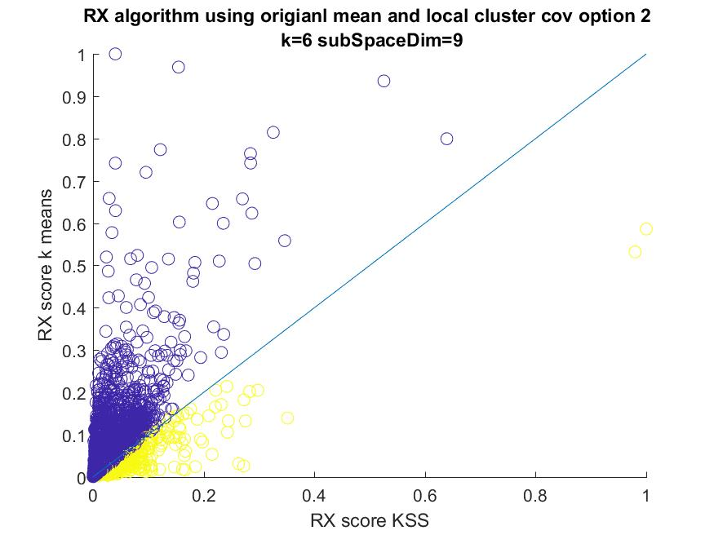
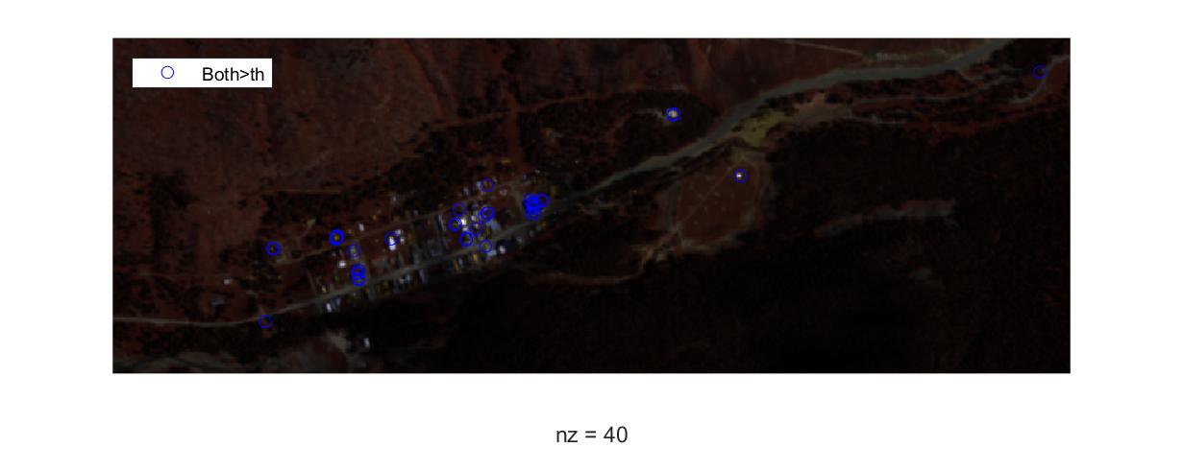
Findings
Indirect cluster approach – applying RX algorithm on each cluster independently using the original mean and the local clusters covariance.
- Whole data Normalization.

Slide 36
Future Goals
Dynamic subspaces algorithms.
Finding a metric for evaluating “performance” of our algorithm according to K parameter and the subspace dimensions.
Creating a new anomaly score based on a weighted sum of different anomaly scores.
Consider soft segmentation process.

Slide 37
Conclusions
Utilize unsupervised machine learning as a pre-processing tool of hyperspectral images can be effective.
There are anomalies we can detect using K-Subspaces that we cannot detect with K-Means, indicating that there is a whole new range of anomalies that we can detect.

